Slide 1
Low Level Radiation
Exposure Risk
or
What You Didn’t
Want to Know About CT

Slide 2
CT has transformed medical imaging
The use of CT has increased rapidly.
Why?
Notes:
CT has transformed medical imaging by providing 3-D views of the organ or body region of interest.
The use of CT has increased rapidly.
~ 3 million CTs in 1980 in the U.S.
> 62 million per year now!
Why?: it’s extremely user-friendly for both patient and physician.

Slide 3
Will CT utilization increase?
If so, why?
Notes:
And, CT utilization is widely projected to increase.
Much of the projected increase in CT scans will come from new screening programs for asymptomatic patients:
CT colonography (“virtual colonoscopy”)
CT lung screening for current and former smokers
CT cardiac screening
CT whole-body screening.

Slide 4
Ionizing radiation
With x-rays,
hydroxyl radicals.
Notes:
Ionizing radiation overcomes the binding energy of the electrons that are orbiting in atoms, knocking electrons out of their orbits, creating ions.
With x-rays, most common is the creation of hydroxyl radicals from x-ray interactions with water molecules. These radicals interact with nearby DNA to cause strand breaks or base damage. X-rays can also ionize DNA directly.

Slide 5
Most radiation-induced damage is rapidly repaired.
DNA double-strand breaks are less easily repaired
and is
linked to the induction of cancer.
Notes:
Most radiation-induced damage is rapidly repaired by various systems within the cell.
However, DNA double-strand breaks are less easily repaired, and occasional misrepair can lead to induction of:
point mutations,
chromosomal translocations, and,
gene fusions,
all of which are linked to the induction of cancer.

Slide 6
BEIR VII (2006)
National Research Council
low-dose exposures
detailed risk estimates for cancer incidence in addition to cancer mortality
the most up-to-date and comprehensive risk estimates for cancer
Notes:
The BEIR VII report is the seventh in a series of titles from the National Research Council that addresses the effects of exposure to low dose LET (Linear Energy Transfer) ionizing radiation and human health. . . .this book draws upon new data in both epidemiologic and experimental research. . . . it is the low-dose exposures that are the focus of the book. So-called late effects, such as cancer, are produced many years after the initial exposure. This book is among the first of its kind to include detailed risk estimates for cancer incidence in addition to cancer mortality. BEIR VII offers a full review of the available biological, biophysical, and epidemiological literature . . . and develops the most up-to-date and comprehensive risk estimates for cancer and other health effects from exposure to low-level ionizing radiation.

Slide 7
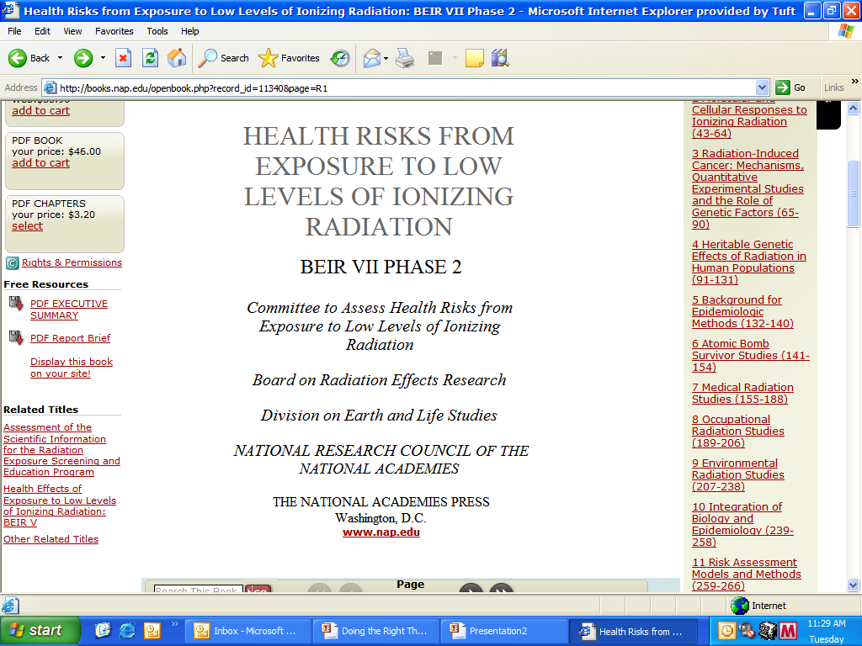
Notes:
You can look this up on the internet yourself, with only a little trouble. Here’s a screen shot of the title page of this report, hundreds of pages long, that reviewed the entire world’s literature in innumerable languages.
It comes from the National Research Council of the National Academies.

Slide 8

Notes:
The National Academy of Sciences is one such Academy. Non profit. Distinguished scholars in science and engineering. The National Academy of Sciences was authorized by Congress in 1863 to advise the government, and it still has that mandate.

Slide 9

Notes:
The National Research Council became the main arm of the National Academy of Sciences in the early 20th century, and is administered by the Academies and the Institute of Medicine.

Slide 10
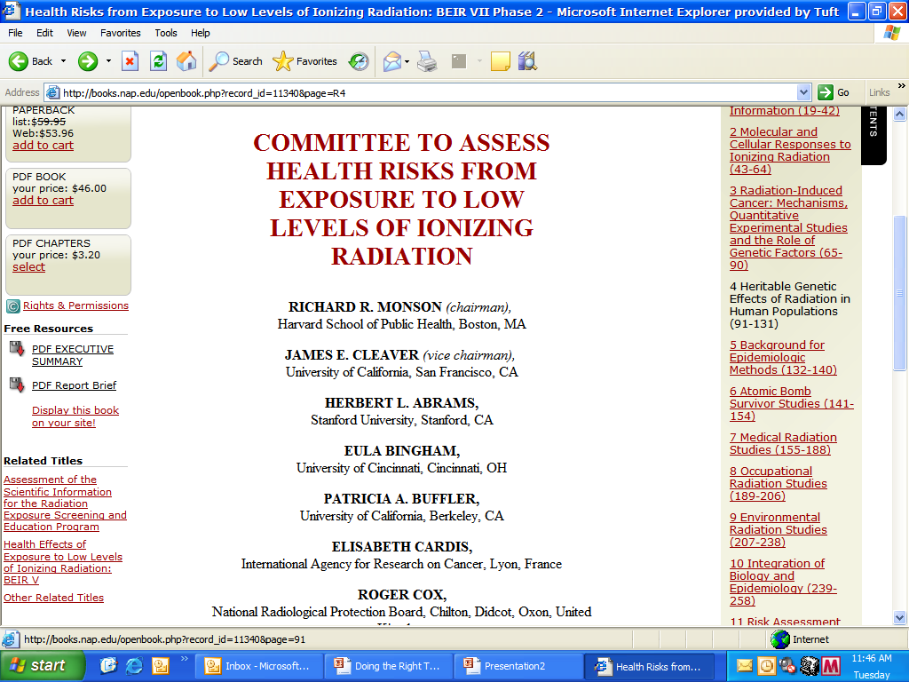
Notes:
These are not slouches. These folks are national and international experts in their fields. The third guy on the list, for instance, had been Chief of Radiology at the Brigham before become the Chief at Stanford. And the list goes on and on, including many experts from abroad.

Slide 11
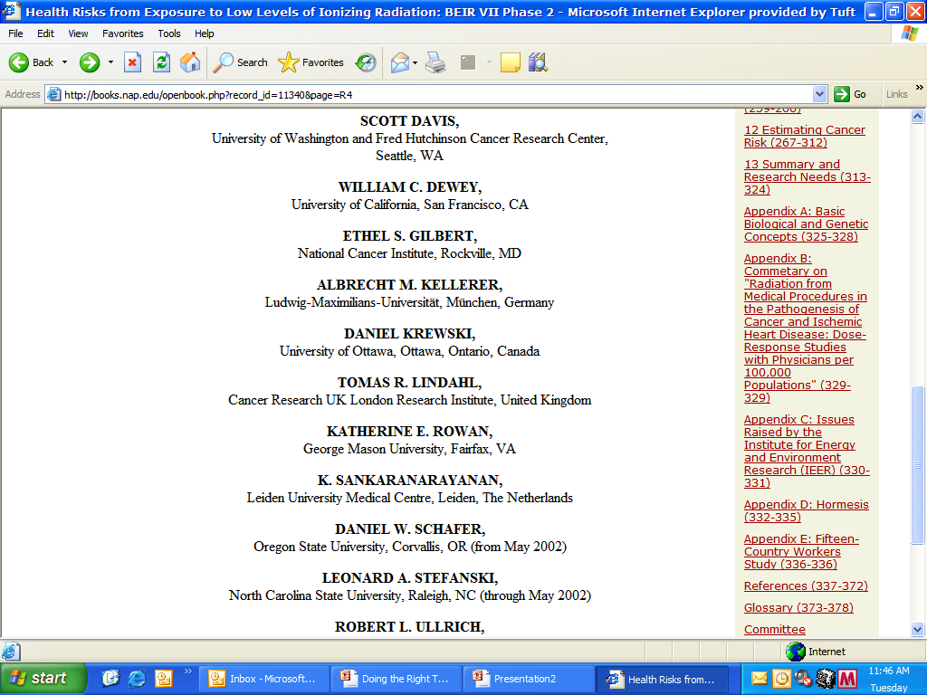
Notes:
More of the same . . . .

Slide 12
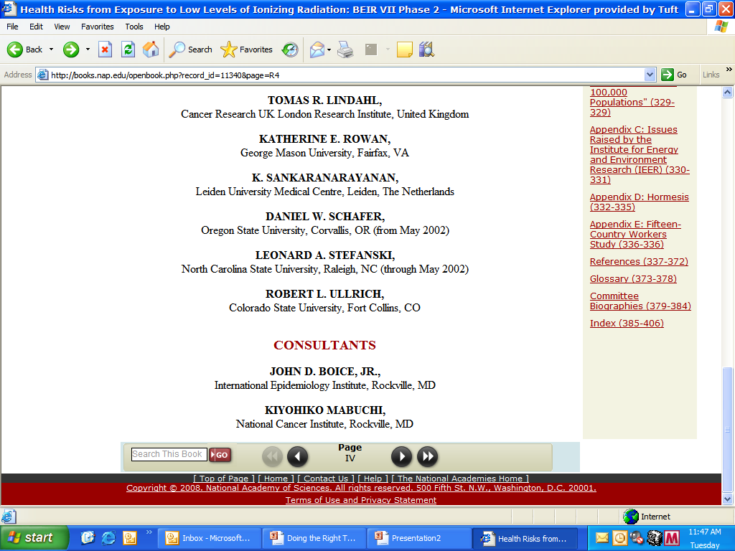
Notes:
Just trying to hammer home the point that these are not a few whackos someplace who wrote a lot about something with which they had insufficient expertise.

Slide 13
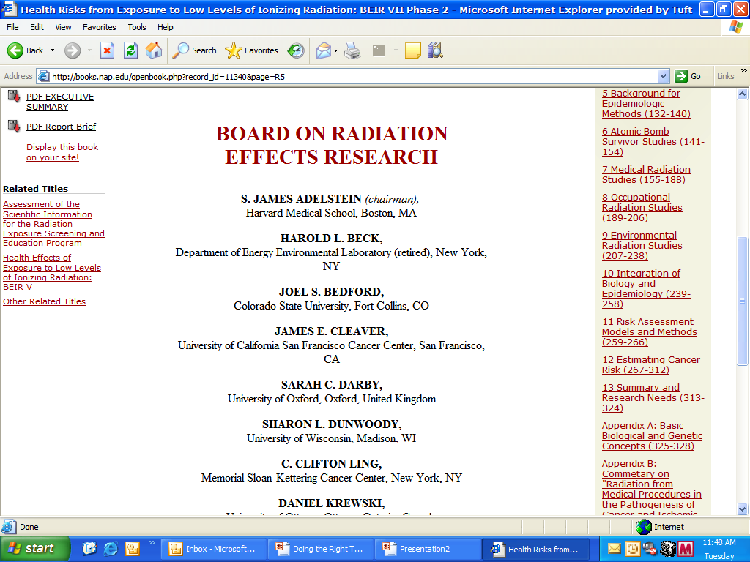
Notes:
The group includes radiologists, but most are radiation biologists, radiation physicists, epidemiologists, and so on.

Slide 14
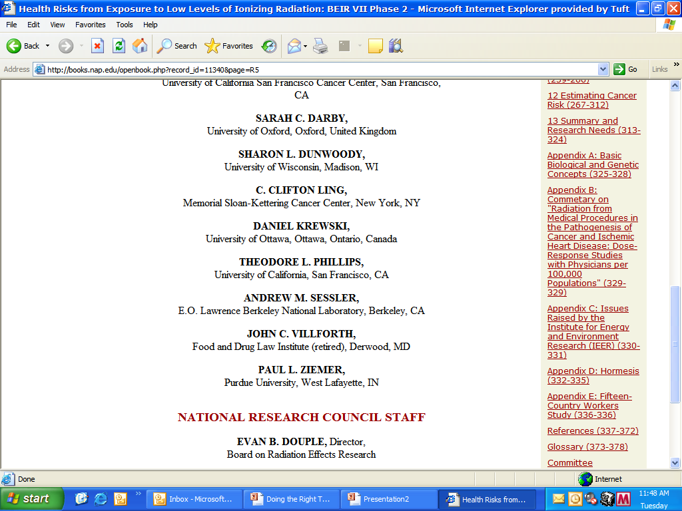
Notes:
You get the picture . . . .

Slide 15
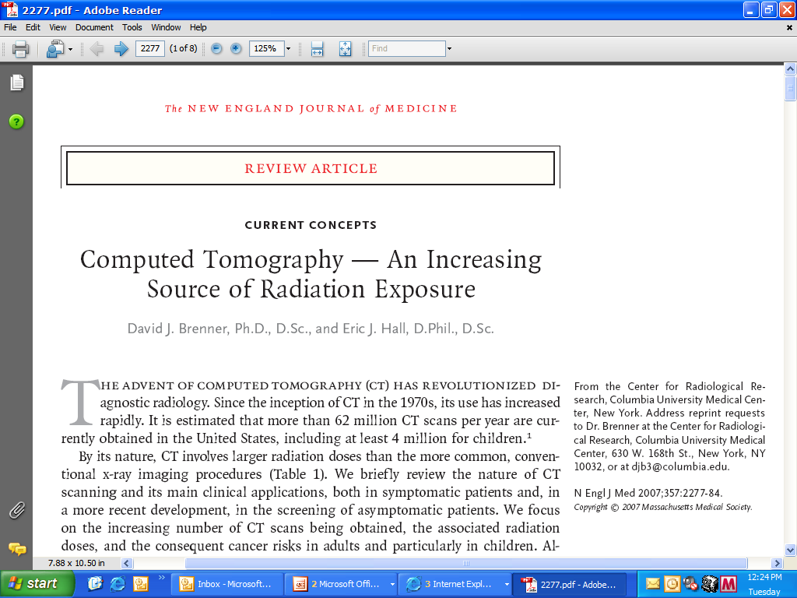
Notes:
Their data, analysis and conclusions were combined with others in important work by Brenner at Columbia, first in the radiology literature having to do with reducing CT radiation exposure to children, and in 2007 in the New England Journal of Medicine with broader clinical applicability and wider readership.

Slide 16
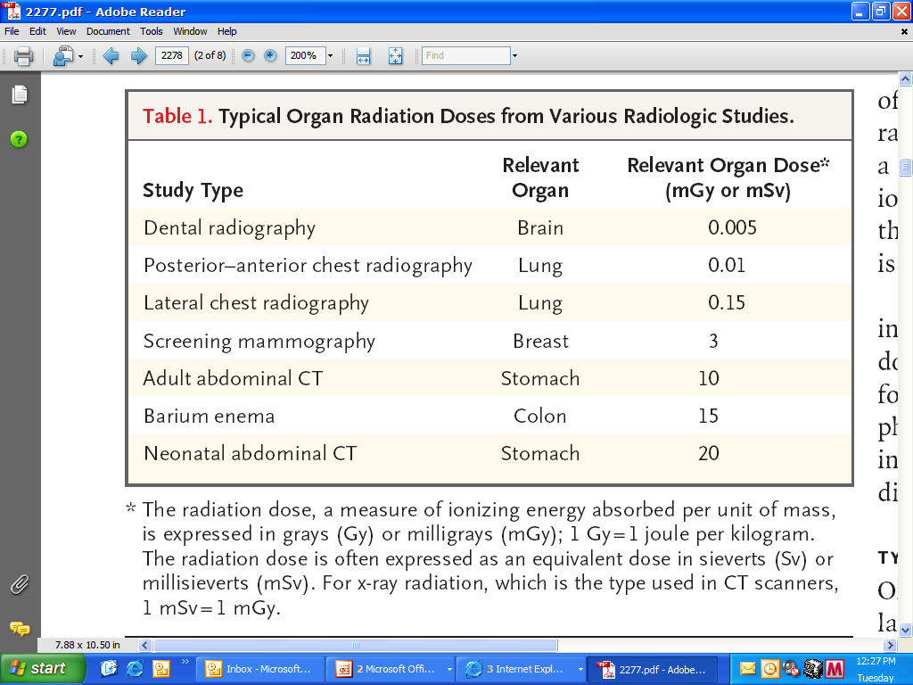
Notes:
Here, you can see that a typical abdomen CT delivers about 10 mSv of radiation dose to an adult, and about 20 to a neonate. Of course, dose is not the only critical aspect. Radiation sensitivity also matters, and differs by age and gender.

Slide 17
A typical CT examination includes ~ 3 CT scans.
Radiation-induced carcinogenesis
Notes:
In addition, one needs to be mindful that a typical CT clinical examination includes about three of what was in the preceding table as an “abdomen CT.” Why? Well, we might do non contrast images first, followed by early phase contrast-enhanced images of the kidneys or liver, followed by delayed images. Were it the pancreas, there’d likely be still another sequence of images.
You get the picture . . . If you folks are worried enough to want a pancreas or liver CT, well, we tend to get the most sensitive images for you as our way of helping, which leads to the most sequences, and the greatest radiation exposure.
This framework is no different here at Tufts from the situation at most academic or community settings.
At these doses, the most likely risk, and the risk we are discussing today, is radiation-induced carcinogenesis.

Slide 18
Increased risk of cancer
Notes:
There is direct evidence from epidemiologic studies that the organ doses of a common CT examination result in an increased risk of cancer.
The evidence is reasonably convincing for adults and very convincing for children.

Slide 19
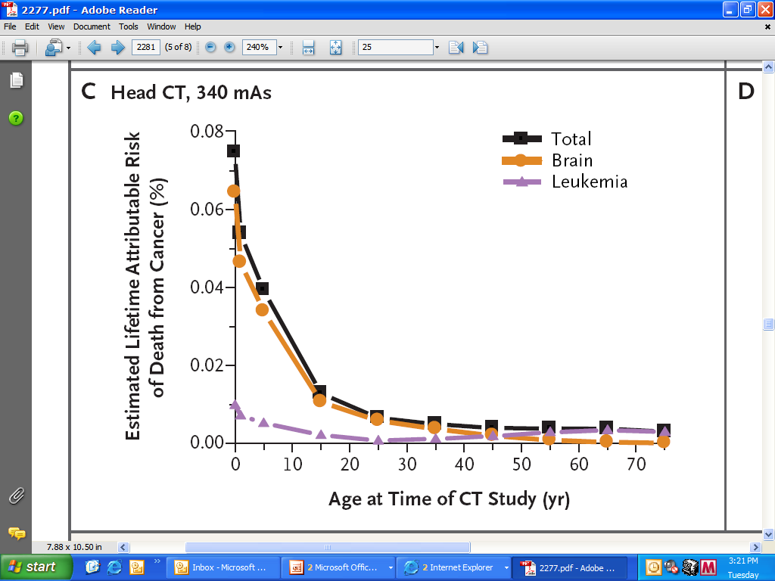
Notes:
From the New England Journal of Medicine article, we see the lifetime attributable risk of death from cancer – attributable here means that one may attribute the cancer to the CT’s radiation exposure – graphed against the age of the patient when the CT was done. For head CTs, the graph suggests a precipitous drop-off in radiation sensitivity at about 8-10 years of age, but not really leveling off until well into adulthood.

Slide 20
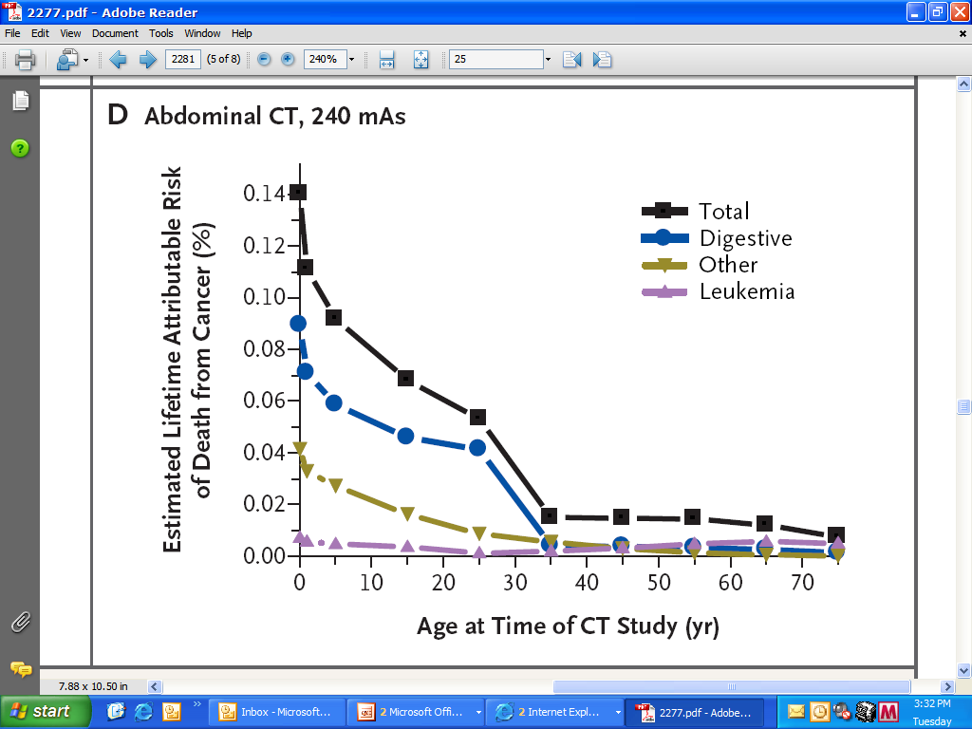
Notes:
But from this graph of abdomen CTs, we can see that the total risk doesn’t really drop off until about age 30 to 35 or so. Remember, we are talking about death from cancers caused by CTs. Some of the cancers caused will be cured, so there actually are even more cancers induced, but the graphs we’re looking at today are only the deaths attributable to such cancers.

Slide 21
~ 1.5—2 %
delayed killing
Notes:
Current best estimates are that ~ 1.5—2 % of all cancers in the U.S. currently are attributable to radiation from prior CT studies.
Put differently, we in medicine – you and I – together – sadly kill a not tiny portion of our patients via CT exams we order or perform. We don’t mean to kill, of course; we mean to diagnose, treat and save.
It isn’t murder and there’s no ill intent – naturally. But we are ordering and doing CTs, and patients are dying because of those CTs. It may take a decade or two for them to die, but it is hard at least for me personally, in my heart, to escape the notion of “delayed killing.” I acknowledge that that’s my own phrase for it – delayed killing.
Do we consider this risk when we order CTs? Do you clinicians really take a good, long, hard look at the risks before placing the order? Do we radiologists often enough decline to do those of your exams that seem only weakly substantiated?
When we do the CTs, do we radiologists lower the radiation dose settings on the machine enough, and often enough, in order to reduce dose and risk? Bear in mind that doing so will reduce image quality, and, at some point, sensitivity. Is it worth it?
Or, do we radiologists presume you clinicians would not order a CT on a mere hunch, because of a borderline lab value, and so on?
These are all questions probably not asked, and certainly not answered, often enough.

Slide 22
not hypothetical
based directly on measured excess radiation-related cancer rates among adults and children
Notes:
To quote these two sources, the “. . . . risks associated with CT are not hypothetical . . . . are not based on models or major extrapolations in dose.
“Rather, they are based directly on measured excess radiation-related cancer rates among adults and children who in the past were exposed to the same range of organ doses as those delivered during CT studies.”

Slide 23
BEIR VII – lifetime attributable risk of mortality, per 100,000 exposed;
single series abdomen (only) CT; solid Ca / leukemia
 | male | female
age 10 | 64 / 7 | 105 / 5
age 30 | 32 / 6 | 49 / 5
age 50 | 29 / 7 | 42 / 5
mixed ages | 41 / 7 48 = ~ 1/2000 pts | 61 / 5 66 = ~ 1/1500 pts
Notes:
Let’s take a look at a table from the BEIR VII study. We are again looking at lifetime attributable risk of mortality from malignancies, solid cancers and leukemia reportedly separately, based on having had one CT image series. Solid cancers dominate the risk pattern.
You will note that risk drops off by age, with youngsters the most sensitive but adults sensitive, too.
Second, you will note that girls are more sensitive than boys, and women more sensitive than men, but risk escapes no one.
Remember importantly to double these values for CTs of abdomen plus pelvis, and to quadruple if both with and without IV contrast. A pancreas protocol might be five times these values or more!

Slide 24
patient dies some years later
Is the risk of this patient dying without the CT greater than with the CT? With the particular CT I am ordering?
Notes:
This is easy unconsciously to put out of our minds, unfortunately, because the patient dies some years later, on someone else’s watch.
It is not unreasonable to suppose that some of us will care for the patients with cancers that our colleagues caused a decade or two earlier. We may care for patients whose malignancies we ourselves caused years earlier. That you, today and tomorrow, may order a CT that causes a malignancy that you yourself may have to care for when you’re my age. Lastly, that you may get a malignancy yourself because of a CT you will have had, that was of course well-intended. I acknowledge I’ve had far too many CTs, myself, before such data became available.
How often do we genuinely, critically ask ourselves, “Is the risk of this patient dying without the CT greater than with the CT? What about the particular CT I am ordering? Could it be a routine, single screening CT of abdomen without pelvis, or need it be both abdomen and pelvis, with and without contrast, and so on?

Slide 25
“. . . literature questioning the use of CT, or the use of multiple CT scans. . . ”
Notes:
To quote the New England Journal of Medicine article, “There is a considerable literature questioning the use of CT, or the use of multiple CT scans, in a variety of contexts, including management of blunt trauma, seizures, and chronic headaches, and particularly questioning its use as a primary diagnostic tool for acute appendicitis in children.”

Slide 26
defensive medicine
or
lack of communication
Notes:
The New England Journal article continues, “. . . a problem arises when CT scans are requested in the practice of defensive medicine, or when . . . [they are] repeated as the patient passes through the medical system . . . [simply] because of a lack of communication.”
You know the scenarios.
The communication one happens far too often. Patient is seen at an ED elsewhere. CT is done. Patient is transferred without the images. We order a repeat CT. When we got the call from the other facility, did we emphasize strongly that we wanted not only the reports but all images? Did we really need to repeat the CT? Could we have gotten the images from the prior hospital the next day? Were images necessary in the first place? Do we do the same when we transfer a patient somewhere else?
It has been estimated in the literature that about a third of all CT scans – although ordered in good faith, of course – are medically unnecessary. My own experience suggests it is likely at least that fraction.

Slide 27
There are three ways to decrease CT exposure risks.
The responsibility of us all !
Notes:
There are three ways to decrease CT exposure risks:
Decrease dose, the machine settings – that’s the responsibility of Radiology Departments.
Replace CT with MRI or US when appropriate – that’s the responsibility of everyone, but most effectively accomplished by requesting providers – unfortunately, it is not routinely but really rather only occasionally clinically appropriate to make such substitution for CT.
Most effective method: decrease exams ordered, the complexity of exams, and the frequency of follow-up exams! – that’s the responsibility of us all!

